Slide 1
PRESENTATION ON
STATIC PROJECT
PLANT WEBSITE
By:
Pratibha Walunj
Guided By:
Jayanth V Sir

Slide 2
AJENDA
Introduction of Topic
Languages used
Screenshots
Conclusion

Slide 3
Introduction
In this Static project I have developed static Website for Plants.
Planting trees is a legacy for yourself, a loved one, and the planet.
Each ring on your tree stands for another year where you made a difference.
In website user can easily register, login for see this website .

Slide 4
Languages Used
HTML
HTML stands for Hyper Text Markup Language.
HTML describe the structure of a Web page
HTML elements tell the browser how to display the
content

Slide 5
Languages Used
CSS
CSS stands for Cascading Style Sheet.
CSS describe how HTML elements are to be displayed .
CSS saves a lot of work. It can control the layout of
multiple web pages all at once.

Slide 6
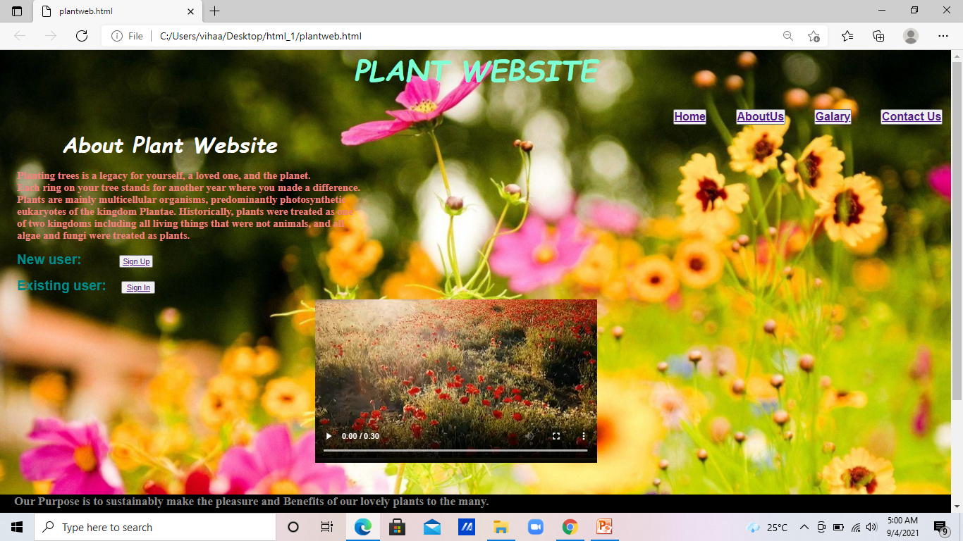
Home Page

Slide 7
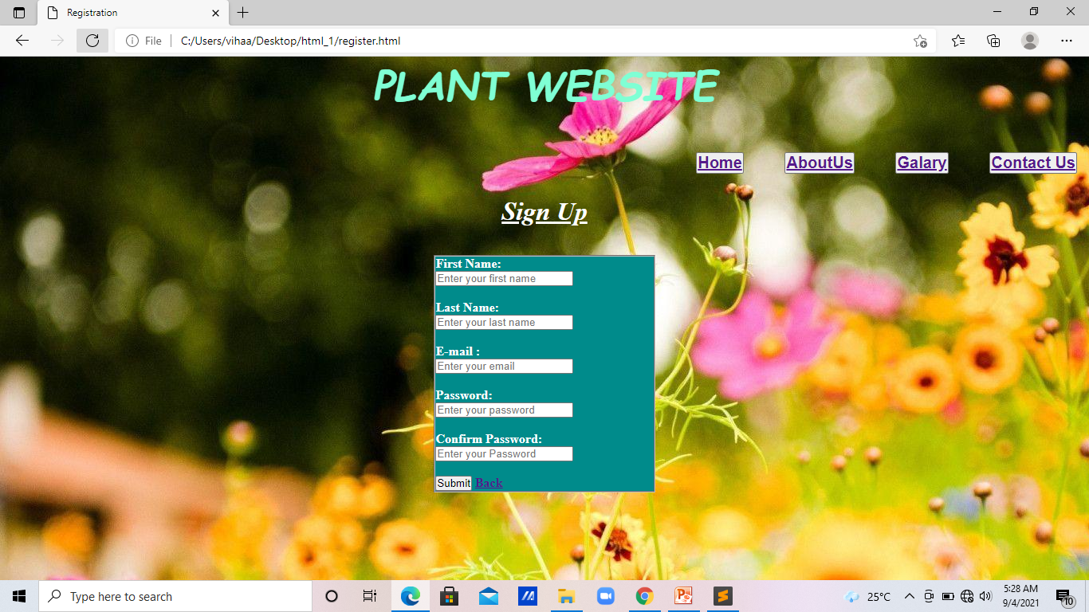
Registration Page

Slide 8
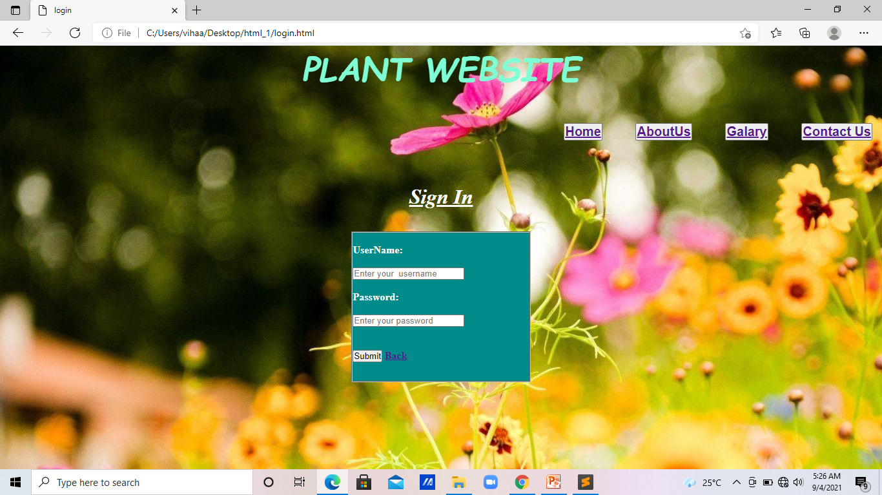
Login Page

Slide 9
Conclusion
The purpose of this website is to make user friendly website where user can easily use it.

Slide 10
Thank You…

